Slide 1
Automated Scalable Deployment using CI/CD Pipeline
Naveen

Slide 2
Agenda
Introduction to the Project
Tools and Technologies Used
Server Setup in AWS EC2
What files I wrote and why?
Jenkins Pipeline – Step by Step
Step-by-Step Workflow
Diagram Explanation

Slide 3
My project is about automating the process of deploying a web application using a CI/CD pipeline. Instead of doing everything manually—like building the app, creating images, sending files, and deploying it—I built a system that does everything automatically from the moment a developer commits code to GitHub.
Introduction to the Project

Slide 4
Tools and Technologies Used
GitHub: Source code
Jenkins: Automation server (CI/CD)
Docker: To containerize the app
Docker Hub: Store Docker images
Ansible: Automation tool for remote commands
Kubernetes (Minikube): For deploying the container as pods
AWS EC2: For hosting Jenkins, Ansible, and Kubernetes

Slide 5
Server Setup in AWS EC2 I used 3 EC2 instances: Jenkins Server – to manage the pipeline Ansible Server – to build images and trigger deployments WebApp Server – hosts Kubernetes using Minikube

Slide 6
What files I wrote and why?
Dockerfile: To build the image of my web application (from a free CSS template)
deployment.yml & service.yml: Kubernetes configs to deploy and expose my app
ansible.yml: Ansible playbook to run kubectl apply and deploy on Kubernetes
Jenkinsfile (Pipeline Script): Automates every step from GitHub to Kubernetes

Slide 7
Jenkins Pipeline – Step by Step
1 .Git Checkout – gets the latest code
2 .Send Files to Ansible – transfers the Dockerfile and app files
3 .Build Docker Image – builds it on the Ansible server
4 .Tag & Push Image – tags and uploads it to DockerHub
5 .Copy to Kubernetes – sends Kubernetes YAML files
6 .Deploy with Ansible – runs Ansible playbook to deploy
.

Slide 8
Step-by-Step Workflow
Developer pushes code to GitHub.
GitHub sends a message to Jenkins using a webhook.
Jenkins receives the message and starts building the project.
Jenkins sends the Dockerfile to the Ansible server.
The Ansible server builds a Docker image of the web app.
Ansible tags the image and pushes it to Docker Hub.
Then, Ansible connects to the Kubernetes cluster
It deploys the Docker image using kubectl commands by running an Ansible playbook.
Finally, the web app runs inside a container in Kubernetes, and we can access it using a NodePort.

Slide 9
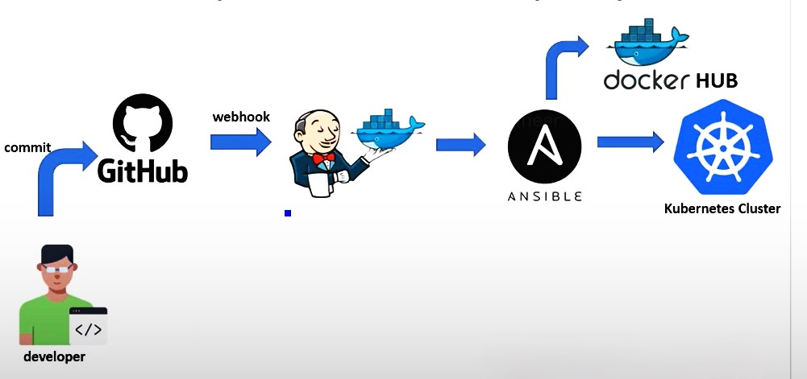
Unlocking new horizons

Slide 10
Thank you

